Slide 1





Beyond the The DfE Grant

Slide 2
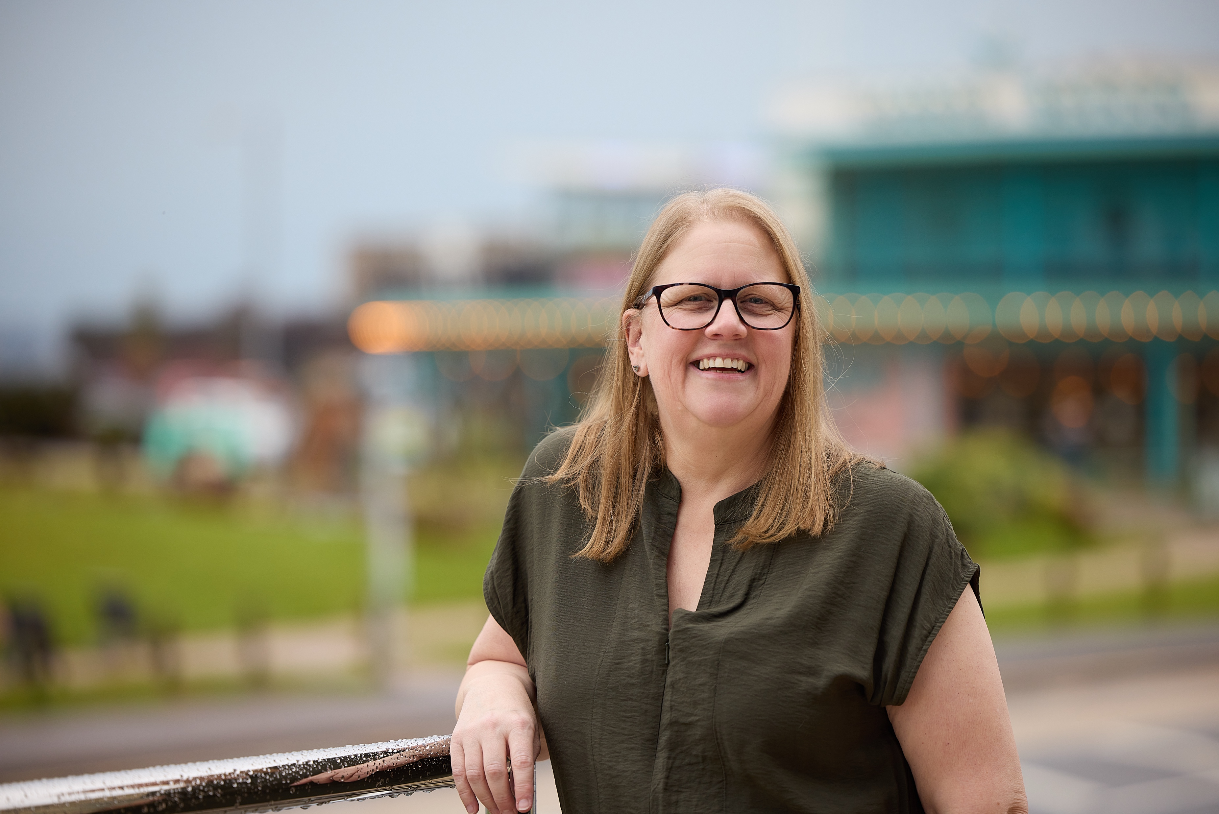

Change begins with passionate people who have a vision
My Business Card

Slide 3



Welcome
Forum friendly income streams
What can you do?
AI Tips and Tricks
Things to consider
Q & A /Feedback
What will we cover today?
What will we cover today?

Slide 4

This session will be 2 hours
There will be a break
We will have breakout rooms
There will be interaction – we can use chat and Slido
Feel free to have cameras on or off
Feel free to doodle, fidget, eat or drink – but on Mute please
Before we start

Slide 5



Do not edit How to change the design
Join at slido.com #3387242
The Slido app must be installed on every computer you’re presenting from

Slide 6
Introductions
Pop an intro into the chat – if you feel comfortable

Slide 7


How confident are you in funding beyond the DfE grant?
Rate yourself
😬 not confident yet
🙂 somewhat confident
😌 fairly confident
😎 confident
🏆 very confident

Slide 8

Do not edit How to change the design
How would you rate your confidence in funding?
The Slido app must be installed on every computer you’re presenting from

Slide 9

What is your top worry about fundraising?

Slide 10

Do not edit How to change the design
what is your top worry about fundraising?
The Slido app must be installed on every computer you’re presenting from

Slide 11
What it is: Small pots for community activity or essentials.
Good for: Wellbeing sessions, accessibility resources, participation costs.
Considerations: Reporting can be fiddly; check if funds are restricted; avoid mission drift.
Small Grants &
Community Funds

Slide 12
What it is: “Friends of the Forum” page + QR at events.
Good for: Small, flexible (unrestricted) costs.
Considerations: Be clear we don’t share personal cases; if you’re not a charity, Gift Aid won’t apply.
Donations & Supporters

Slide 13
What it is: Local businesses cover practical costs or donate time/resources.
Good for: venues, print, snacks, prizes.
Considerations: Use independence wording in thanks; no product endorsement; track value for records.
Sponsorship
in Kind

Slide 14
What it is: Small, friendly community events.
Good for: Engagement + modest funds.
Considerations: Raffles/lotteries: check local rules/licensing. Keep it inclusive and low-pressure.
Forum Fundraising
Raffle/Quiz/ Bake Sale

Slide 15
What it is: A time-bound page for one clear purpose.
Good for: One-off items (e.g., sensory kits, accessibility upgrades).
Considerations: Needs crisp story + regular updates; watch platform fees; ensure you update with results.
Crowdfunding/
Appeals

Slide 16
What it is: Employers match staff donations; payroll giving for registered charities/CICs.
Good for: Doubling impact of small gifts.
Considerations: Payroll giving tax benefits are charity/only; matched giving can apply to CICs but depends on employer policy.
Matchfunding & Payroll Giving

Slide 17
What it is: Simple, clearly-scoped paid tasks that use Forum strengths.
Good For: Engagement + modest revenue or full cost recovery.
Considerations: Safeguarding and accessibility; clear scope; capture quotes/numbers for evidence; qualified/trained staff.
Traded Services/
Workshops

Slide 18
What it is: Team up; you bring the parent voice and reach.
Good for: Larger pots or projects you can’t deliver alone.
Considerations: Write a short MOU; clarify independence and roles; agree reporting and data protection.
Partnerships &
Joint Bids

Slide 19
What it is: Take a quick look at spending, find better deals, minimise waste; log savings like income.
Good for: Stretching the grant, building a small reserve, smoothing cashflow.
Considerations: cancel duplicates; move to free/charity tiers; three quotes over £250
Cost Cutting

Slide 20

Interview with
Kenton Mee
Links to follow

Slide 21
10 minute BREAK

Slide 22
Things to consider

Slide 23
Can the steering group continue to make decisions in the best interests of the Forum?
Can we identify, record, and manage conflicts of interest
Independence & conflicts

Slide 24
Will this distract us from our core purpose: parent carer participation in the area?
What is the participation outcome this funding will enable?
Purpose fit

Slide 25
Do we have the time, skills and headspace to meet the outcomes without
overloading volunteers?
If not, can we scale down, phase, or partner to make it manageable?
Capacity To Deliver

Slide 26
Does this put us at risk of breaching the DfE grant conditions, the HM Code for grant recipients, or our Memorandum of Understanding?
If anything is unclear, pause and seek guidance before proceeding.
Compliance with existing duties

Slide 27
Could this harm our constructive, trusted relationships with parent carers or strategic partners?
Trust & Relationships

Slide 28
Time for a breakout

Slide 29
Why choose this tactic?
What 3 things would be first on your action plan?
What help would you need?
What risks or considerations are there?
In groups choose one tactic

Slide 30

Using AI in your plan
Notes:
https://drive.google.com/file/d/1plLErK3Mavk8L5Iqit3vID1GZjx0ZLFn/view?usp=sharing
Link to google doc – share in comments

Slide 31
You are my Funding Radar for a Parent Carer Forum in [Town/LA/Region].
Every week, list 5–10 **new or currently open** opportunities that fit:
- small grants (≤ £10,000)
- local philanthropy or community foundations
- in‑kind sponsorship (rooms/printing/refreshments)
- National Lottery community/“Awards for All” style grants
For each opportunity give: name, deadline, what it funds (one line), effort level (low/med), and the **first step** we should take.
Exclude anything irrelevant or very high effort. Keep it to a one‑page summary.
AI – Finding Finder
Get a short list of small grants, local philanthropy and in‑kind support every week.

Slide 32
AI – Grant Bid
Turn this activity outline into a one‑page small‑grant proposal for a Parent Carer Forum: [paste your outline].
Include: aim, who benefits, 3 measurable outcomes, delivery outline, safeguarding note, simple budget (headings only), and a 60‑word summary suitable for a “project description” box. British English.
Turn a simple idea (e.g., wellbeing day or peer support) into a grant‑ready one‑pager.

Slide 33
Write plain‑English copy for a “Friends of the Forum” donate page for a Parent Carer Forum.
Sections: headline (≤ 7 words), a 60‑word impact story, “What £3/£5/£10 funds” bullets,
privacy reassurance (no personal cases shared), and a warm one‑line thank you.
Tone: welcoming, independent, family‑centred. British English
**************************************
Create 3 short social captions (≤ 40 words each) and one 40‑word poster blurb inviting people to scan a QR code to donate. Include one concrete example of what a small gift funds. Avoid urgency or guilt.
AI – Online Appeal
Launch a simple donate page (“Friends of the Forum”) with a QR for events/leaflets.

Slide 34
Don’t paste personal/sensitive data; keep examples generic.
Treat AI output as a first draft; human-check facts, numbers, and legal wording.
Keep to DfE grant/HM Code/MoU conditions, when in doubt, ask.
AI Safeguards

Slide 35

We need your feedback
Notes:
Also to add here:
Contact and the NNPCF are currently exploring approaches and agreements between forums, ICBs, LAs and other partners that provide funding to forums with an aim of providing good practice examples to support more forums and their strategic partners to find models that work for them. If you have an example, you feel works for you, please tell us at parent.participation@contact.org.uk

Slide 36

What have been your key takeaways today?

Slide 37



ANY
QUESTIONS

Slide 39
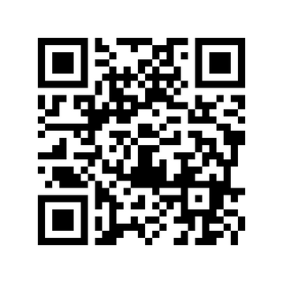
Building the future of work with
NEURODIVERSITY
in mind
inclusivechange.co.uk
icaw-cic.com

