Slide 1



Confidential Careline
for Contact

Slide 2


Wellbeing
35 years of delivering EAP’s
Clinical excellence & capability
Ease of access
Customised approach
Personalised journeys

Slide 3
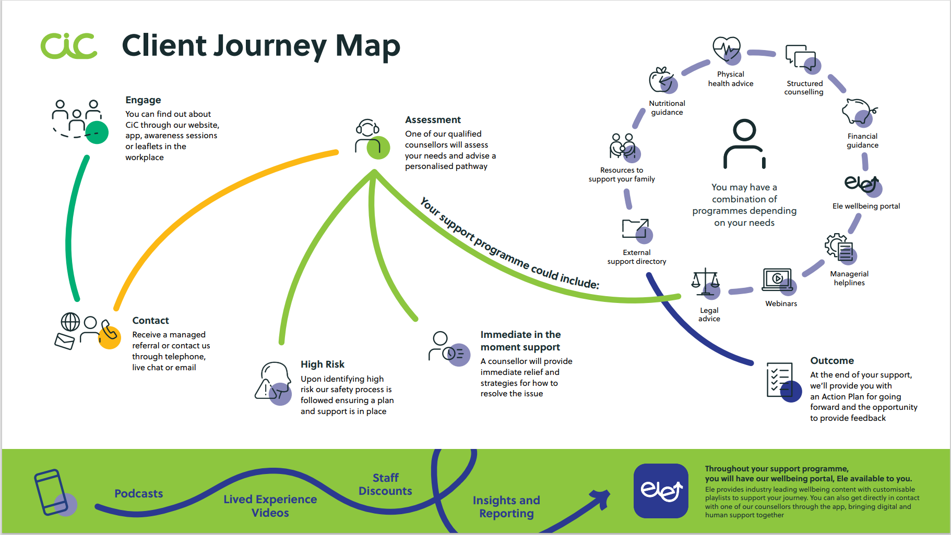

Slide 4

Around the Clock Support
Confidential, in the moment support
Access via email, live chat or free phone number
Work & life issues
Emotional, psychological and practical support
24/7/365

Slide 5

Structured Therapy
Solution-focused brief therapy
Specialist psychological support
Delivered via face to face, telephone or video
In accordance BACP Ethical Framework
Referral & signposting to other services

Slide 6

Managerial Adviceline
Support for managers facing challenges within their team
Expert training in human behavior and relationships
Staffed by workplace psychologists
Strategies for dealing with difficult events
Confidential discussions

Slide 7

Legal Advice Service
Free impartial legal advice whenever you need it.
Dedicated and experienced advisors
Efficient and practical advice on a full range of complex and sensitive legal and tax issues
Family Law - Personal Injury - Landlord and Tenant Disputes - Consumer Law - Discrimination - Health and Safety - Planning Matters
Access to one legal call per area of law every 12 months

Slide 8

Financial Advice Service
Long-term support to help you manage your own finances more efficiently.
Support with debt and other financial worries
Industry leading financial support service
Clear and impartial advice from experienced financial advisors
Managing debt, Budgeting, Credit card, Investments, Pensions, Savings, Tax, Banking and more

Slide 9

Monthly Webinars
Up to 4 free webinars every month
Delivered by CiC clinical experts and guest speakers
Covering themes such as Neurodiversity, Physical Health, Nutrition, Mental Health and Financial Health
All webinars uploaded to Ele wellbeing platform

Slide 10
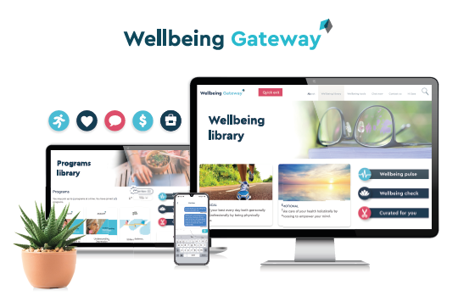
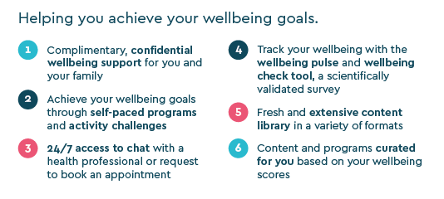
A mobile app, available through all major app providers
Digital Platform:
Introducing Wellbeing Gateway
A mobile app, available through all major app providers
Personalised wellbeing programmes tailored to individual needs
Integration with wearable technology to support activity and exercise tracking

Slide 11

Accessibility & Equity
Our services address diverse employee needs and accessibility:
Flexible access options including Live Chat, Online Booking, email, speech and text options via Relay UK
Adviceline trained to support clients with diverse requirements including Neurodiversity
Access to Neurodiversity webinars and Ele content
Option to express preferences for counsellor across a full range of protected characteristics
Established network of specialist and multi-lingual counsellors
WCAG compliant written web content

Slide 12
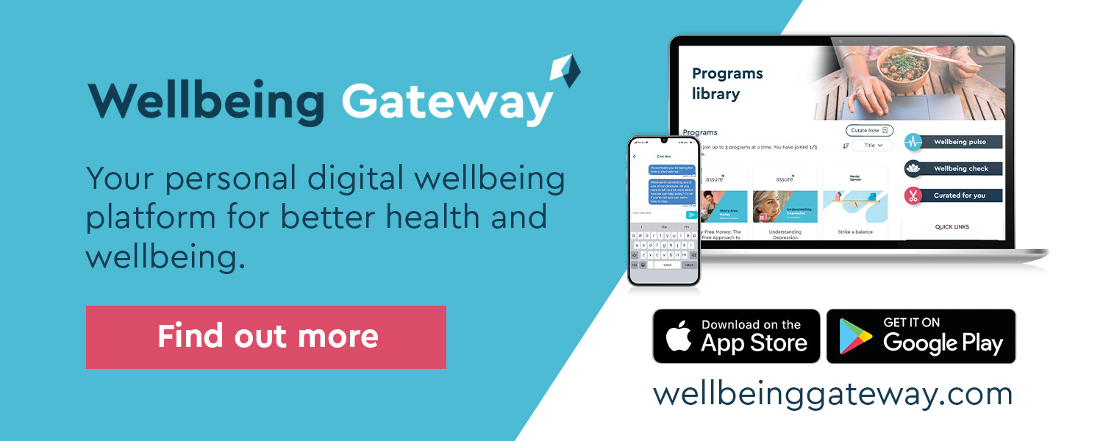
What’s included
Access to Benefit Hub - an employee discounts and perks platform with savings on everyday essentials and experiences.
A wide range of new wellbeing content from experts around the world
Personal, team and organisation‑wide wellbeing challenges
A comprehensive library of wellbeing resources

Slide 13

Access Details:
24/7 Freephone number UK Access Number: 0800 085 1376 + 44 (0)20 7938 0963
Dedicated Managerial Adviceline UK Access Number: 0800 085 3805
Email: assist@cicwellbeing.com

Slide 14
Thank you

